Slide 1

Metric Clustering to Minimize the Sum of Radii
By Huzaifa Ahmad Awan

Slide 2
Introduction: Problem Overview
Given n-point metric (P,d) and integer k>0, goal is to cover P by at most k balls minimizing sum of radii.

Slide 3
Real-world motivations
• Cell towers with minimal coverage radius
• Emergency service location where response radius matters
• Network facility placement
Notes:
Give brief stories or industry examples for each bullet.

Slide 4
Cell Towers
An internet provider must place k cell towers in a city so that all customers are within range
A larger coverage radius requires more transmit power/expensive hardware
Notes:
Sketch small figure: sensors and base stations; show difference between minimizing max radius vs sum.

Slide 5
Facility Network
A company can afford k warehouses across n cities and wants fast delivery for all their customers
The radius of each facility correlates with delivery distance/shipping time/operational cost.
Notes:
Suggest when sum-of-radii matches business metric better than k-means.

Slide 6
Emergency Response
• Hospitals/Fire Stations: A city must position k hospitals/ fire stations so that every neighborhood lies within the service radius of at least one station..
• Cost model: radius correlates with service quality / response time.
Notes:
Discuss realistic assumptions that validate the model.

Slide 7

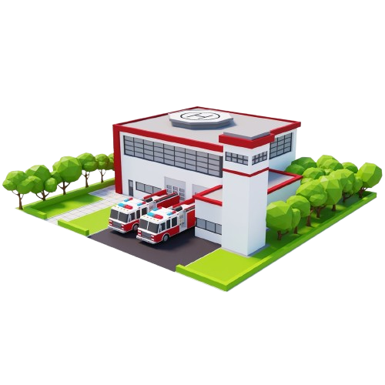


Slide 8
Useful but NP-Hard

Slide 9
Brute Force Algorithm

Slide 10





Brute Force Algorithm
Enumerate every possible ball
$$center x∈P,radius r=d\left(x,y\right) with y∈P→n centers∗n possible radii=n^{2}$$
Enumerate every subset of at most k balls
Check which subsets fully cover P
$$for each ball check which points it covers → O(kn)$$
Compute their cost
Return the subset with minimum cost
$$T\left(n,k\right)=O(n^{2})+O(\left({n^{2} \atop k}\right))∗O\left(kn\right)$$
$=O(n^{2})+O\left(n^{2k}\right)∗O\left(kn\right)$
$$= O(n^{2k})$$
$$\sum_{i=0}^{k}{\left({n^{2} \atop k}\right)}$$
n=20 and k=5
$$\left({n^{2} \atop k}\right)=\left({{20}^{2} \atop 5}\right)=\left({400 \atop 5}\right)≈8∗{10}^{10}$$
$$⇒ 80 billion \text{candidates}$$

Slide 11
A Randomized Quasi-Polynomial Exact Algorithm

Slide 12
High Level Idea
Randomly partition the point set P s.t. most balls in the optimal solution are not cut.
When balls aren't cut, the problem separates cleanly into independent subproblems.
After that guess the small number of balls that are cut (because these must be added explicitly) and
recursively computes optimal covers for each non-cut region.

Slide 13
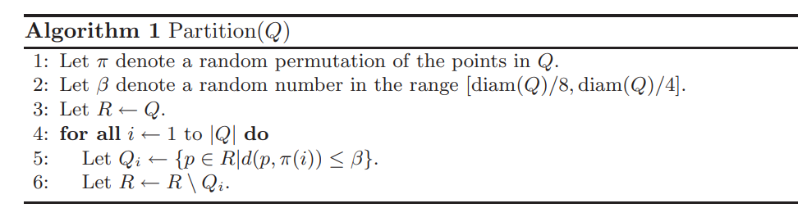
Step 1: Construct random partition
We probabilistically partition the metric into sets with at most half the original diameter
then with high probability only O(log n) balls in the optimal k-cover of P are “cut” by the partition
Notes:
Paste formal definition from Gibson paper here.

Slide 14

Lemma 1.
Lemma 1. Let B ⊆ P be some ball of radius r. The probability that B is cut by the partition of Q output by Partition(Q) is at most $\frac{r}{diam(Q)}$O(log |Q|).
“The larger the ball compared to the whole set, the more likely it is cut. The smaller the ball, the less likely it’s cut”
Notes:
Add the inequality and short proof sketch from Gibson.

Slide 15

What does “cut” mean?
When the Partition algorithm creates sets
$$Q_{1},Q_{2},…,Q_{τ},$$
Ball $B$is cut if points of $B∩Q$end up in different subclusters $Q_{i}$and $Q_{j}$.
Example:
A ball $B$from OPT contains points in two different parts, for example some points in ${ Q}_{2}$and some in $Q_{5}$
This is bad for the algorithm, because we want most optimal balls to fall inside one partition to recurse independently.

Slide 16

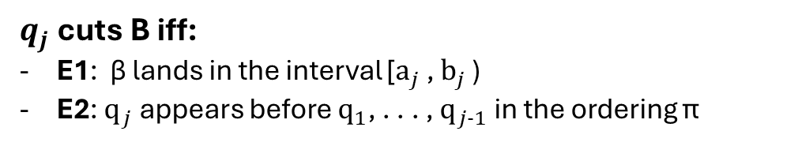
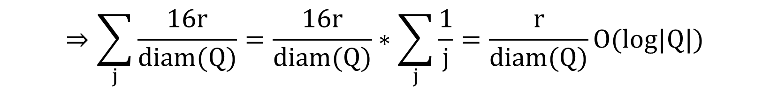
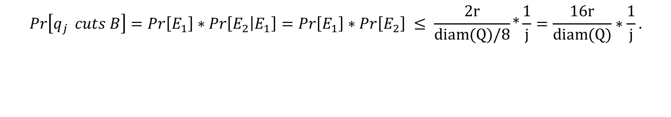

proof.
For each $q_{j}$let $a_{j}$ (resp. $b_{j}$ ) denote the distance to the closest (resp. furthest) point in B
By the triangle inequality:
$$b_{j}−a_{j}≤2r$$
We say that π(i) cuts B if π(i) settles B and at least one point in B is not assigned to Qi .
$q_{j}$ cuts B iff:
E1: β lands in the interval [$a_{j}$ , $b_{j}$ )
E2: $q_{j}$ appears before $q_{1}$, . . . , $q_{j−1}$ in the ordering π
$$Pr\left[q_{j } cuts B\right]=Pr\left[E_{1}\right]∗Pr\left[E_{2} | E_{1}\right]=Pr\left[E_{1}\right]∗Pr\left[E_{2}\right] ≤ \frac{2r}{diam(Q)/8}∗\frac{1}{j}=\frac{16r}{diam(Q)}∗\frac{1}{j}.$$
$$⇒\sum_{j}{\frac{16r}{diam(Q)}}=\frac{16r}{diam(Q)}∗\sum_{j}{\frac{1}{j}}=\frac{r}{diam(Q)}O(log|Q|)$$

Slide 17
Lemma 2.
Lemma 2. The expected number of balls in S that are cut by Partition(Q) is O(log |Q|). Consequently, the probability is at least 1/2 that the number of balls in S that are cut by Partition(Q) is at most c log n, where c > 0 is some constant.
“It means the random partition almost never destroys “too much” of the optimal solution.”
Notes:
Add the inequality and short proof sketch from Gibson.

Slide 18
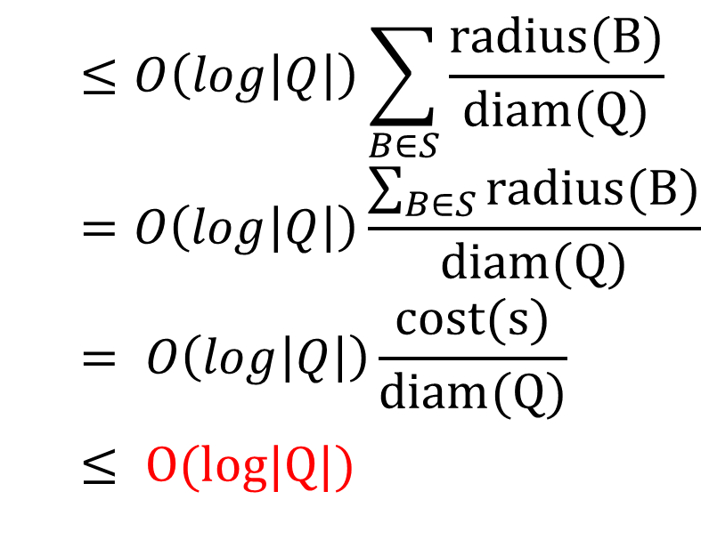
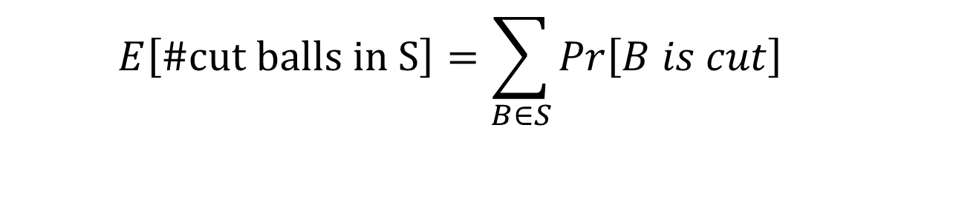
proof.
$$E\left[\text{\#}\text{cut} \text{balls} \text{in} \text{S}\right]=\sum_{B∈S}{Pr\left[B is cut\right]}$$
$$≤O\left(log\left|Q\right|\right)\sum_{B∈S}{\frac{radius(B)}{diam(Q)}}=O\left(log\left|Q\right|\right)\frac{\sum_{B∈S}{radius(B)}}{diam(Q)}= O\left(log\left|Q\right|\right)\frac{cost(s)}{diam(Q)}$$
$$≤ O(log|Q|)$$

Slide 19
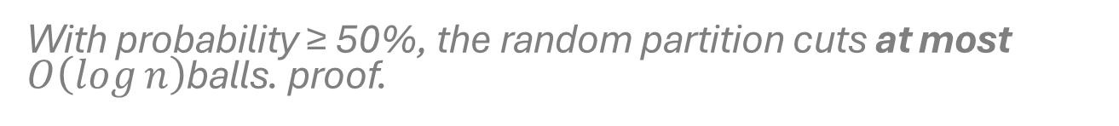
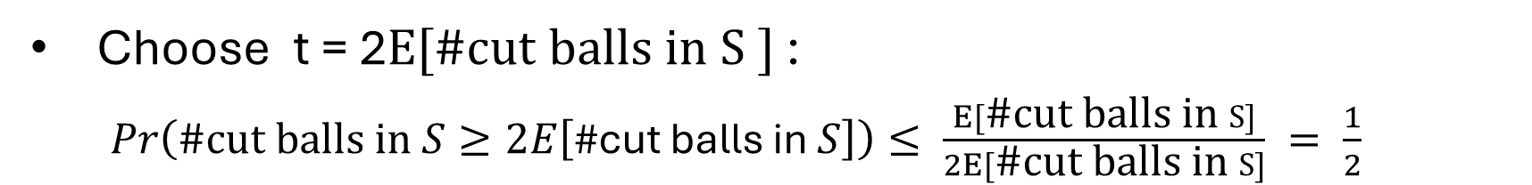
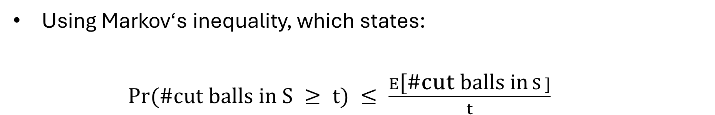
With probability ≥ 50%, the random partition cuts at most $O\left(\log{n}\right)$balls. proof.
$E[\text{\#}\text{cut} \text{balls} \text{in} S] ≤ O(log n) ≤ c log n$
Using Markov‘s inequality, which states:
$Pr(\text{\#}\text{cut} \text{balls} \text{in} S ≥ t) ≤ \frac{E\text{[}\text{\#}\text{cut} \text{balls} \text{in} S ]}{t}$
Choose t = 2$E\text{[\#}\text{cut} \text{balls} \text{in} S ]$:
$Pr\left(\text{\#}\text{cut} \text{balls} \text{in} S≥2E\left[\text{\#}\text{cut} \text{balls} \text{in} S\right]\right)≤ \frac{E[\text{\#}\text{cut} \text{balls} \text{in} S]}{2E[\text{\#}\text{cut} \text{balls} \text{in} S]} = \frac{1}{2}$
$$⟺ Pr(\text{\#}\text{cut} \text{balls} \text{in} S ≤ c log n) ≥ 1−\frac{1}{2} =\frac{1}{2}$$

Slide 20

Step 2: Guess the part of OPT affected by the random partition.
Since we do not know OPT, the algorithm tries all possible choices
$$C⊆\text{all} \text{balls}, ∣C∣≤\log{n}.$$
This seems enormous, but:
# of balls is $O\left(n^{2}\right)$ → choosing ≤ log n of them gives:
$$\left({n^{2} \atop log n}\right)=O(n^{log n})$$
The key: if the partition worked, one of these “guessed“ sets is exactly the set of OPT’s cut balls.
Notes:
Explain merging strategy and handling boundary radius costs.

Slide 21

Example
Imagine:
We have 8 points: p1, p2, p3, p4, p5, p6, p7, p8
OPT uses k=3 balls:
B1={p1,p2,p3}
B2={p4,p5,p6}
B3={p7,p8}
A random partition might group them like:
Q1={p1,p2,p3,p4}
Q2={p5,p6}
Q3={p7,p8}
Now note:
B1 $⊆$ Q1$→$not cut
B2 is split: p4 $∈$ Q1, p5,p6$∈$ Q2 $→$cut
B3 $⊆$ Q3$→$not cut
The algorithm will try C = {ball #5}, C = {ball #17}, etc., and eventually tries exactly C = {B₂}, thereby “guessing right”.

Slide 22

Step 3: Recursively solve each Q′ᵢ
Form the reduced regions $Q_{i}^{′}$
Recursively solve subproblems
Build larger and larger unions $R_{i}$
DP to combine region-solutions
Final assembly
Notes:
Show how enumeration cost is bounded; point to QPT complexity reasons.

Slide 23

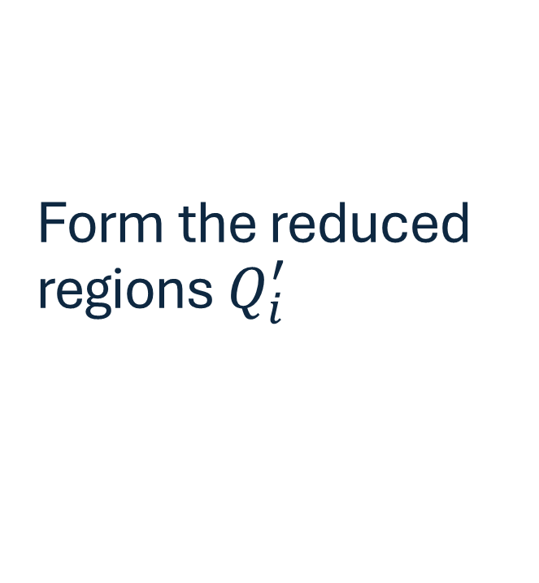
Form the reduced regions $Q_{i}^{′}$
For each region:
$$Q_{i}^{′}=Q_{i}∖\bigcup{C}.$$
These are the parts that remain uncovered after placing the cut balls.
Example: If C = {B₂} covered p4–p6, then
Q₁' = {p1,p2,p3}
Q₂' = ∅
Q₃' = {p7,p8}

Slide 24

Recursively solve subproblems
For each region $Q_{i}^{′}$and for each ball budget 0 $≤ κ_{1}≤κ$, compute:
$$\text{best}\left(Q_{i}^{′} , κ_{1}\right)=\text{optimal} \text{κ}\text{₁}\text{−}\text{cover} \text{for} Q_{i}^{′}.$$
These are recursive calls.
We store all of them.
This gives us all ways to cover each region using any possible number of balls ≤ κ.

Slide 25

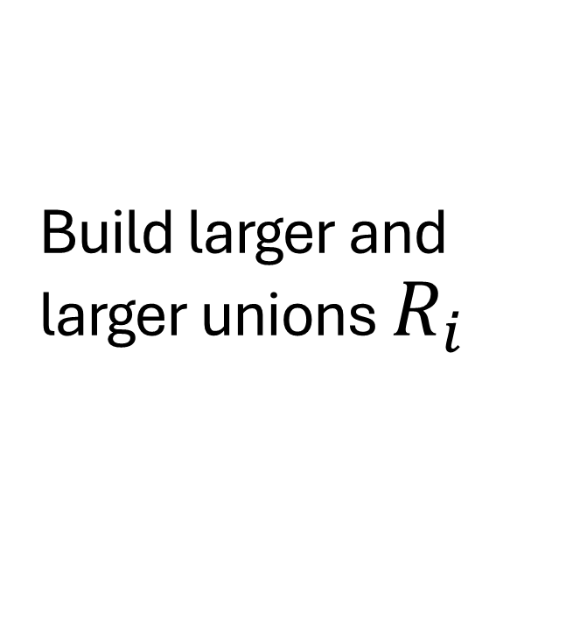
Build larger and larger unions $R_{i}$
Define
$$R_{i}=Q_{i+1}^{′}∪Q_{i+2}^{′}∪⋯∪Q_{τ}^{′}$$
This means:
$R_{τ−1}=Q_{τ}^{′}$
$R_{τ−2}=Q_{τ−1}^{′}∪Q_{τ}^{′}$
etc.
The idea is that we want to combine the solutions of subregions in some order so we can DP them.

Slide 26

DP to combine region-solutions
For each $i$ from $τ−2$down to 0, and for each budget $κ_{1}$:
$$\text{best}\left(R_{i} , κ_{1}\right)=\min_{κ^{′}≤κ_{1}}{[\text{best}\left(Q_{i+1}^{′} , κ^{′}\right)∪\text{best}\left(R_{i+1}^{′} , κ_{1}−κ^{′}\right)]}$$
If you allocate κ’ balls to region Q_{i+1}’,
Then κ₁ − κ’ balls remain for the union of later regions.

Slide 27

Final assembly
Finally:
$$S=\text{best}\left(R_{0} , κ−∣C∣\right) ∪ C.$$
This means:
κ balls total,
|C| of them are used for the cut balls,
κ−|C| remain for the rest of Q.
Among all guesses of C, pick the lowest cost solution.
One guess corresponds exactly to OPT: this returns OPT.

Slide 28

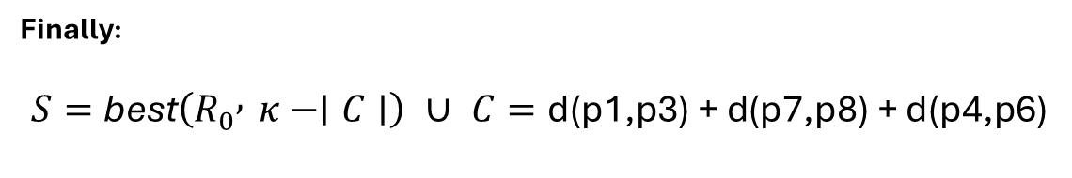

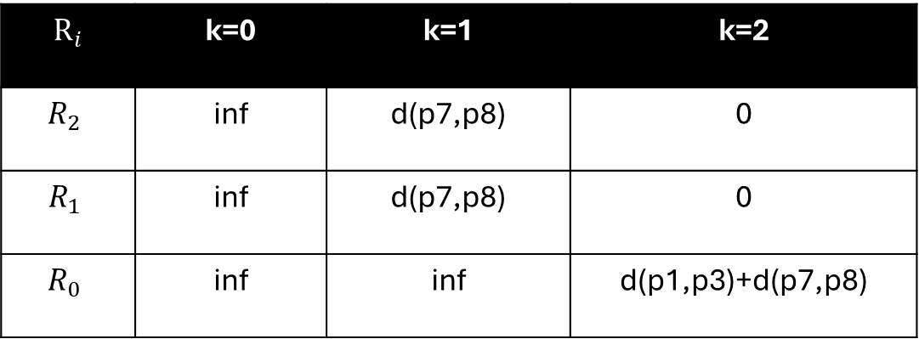
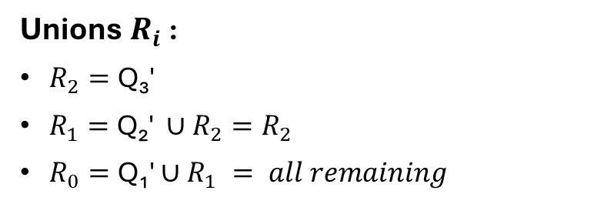
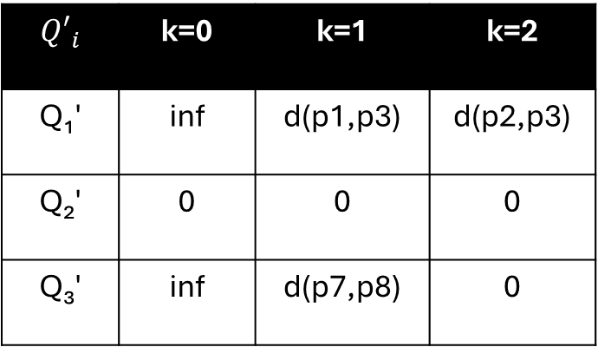
Example
Continuing with the earlier example:
Assume:
C = {B2} ={p4,p5,p6}
Q₁′ = {p1,p2,p3}
Q₂′ = {}
Q₃′ = {p7,p8}
k = 3
|C|=1 $→$ k - |C| = 2 left for Q
Unions $R_{i}$:
$R_{2}=\text{Q}\text{₃}\text{′}$
$R_{1}=\text{Q}\text{₂}\text{′ }∪R_{2}=R_{2}$
$R_{0}=\text{Q}\text{₁}\text{′}∪R_{1} = all remaining$
$$R_{i}$$ | k=0 | k=1 | k=2
$$R_{2}$$ | inf | d(p7,p8) | 0
$$R_{1}$$ | inf | d(p7,p8) | 0
$$R_{0}$$ | inf | inf | d(p1,p3)+d(p7,p8)
Recursion: Compute best(${Q′}_{i}$,k)
$${Q′}_{i}$$ | k=0 | k=1 | k=2
Q₁′ | inf | d(p1,p3) | d(p2,p3)
Q₂′ | 0 | 0 | 0
Q₃′ | inf | d(p7,p8) | 0
Finally:
$$S=\text{best}\left(R_{0} , κ−∣C∣\right) ∪ C=\text{d}\text{(}\text{p}\text{1}\text{,}\text{p}\text{3}\text{) + }\text{d}\text{(}\text{p}\text{7}\text{,}\text{p}\text{8}\text{)}\text{ + }\text{d}\text{(}\text{p}\text{4}\text{,}\text{p}\text{6}\text{)}$$

Slide 29
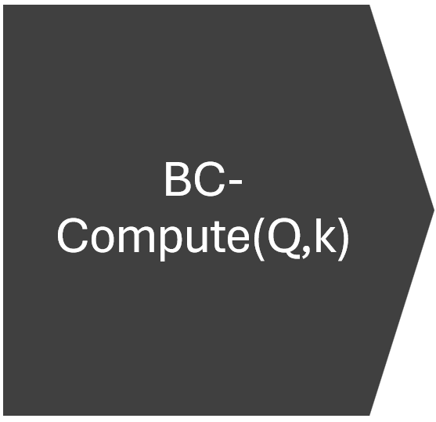
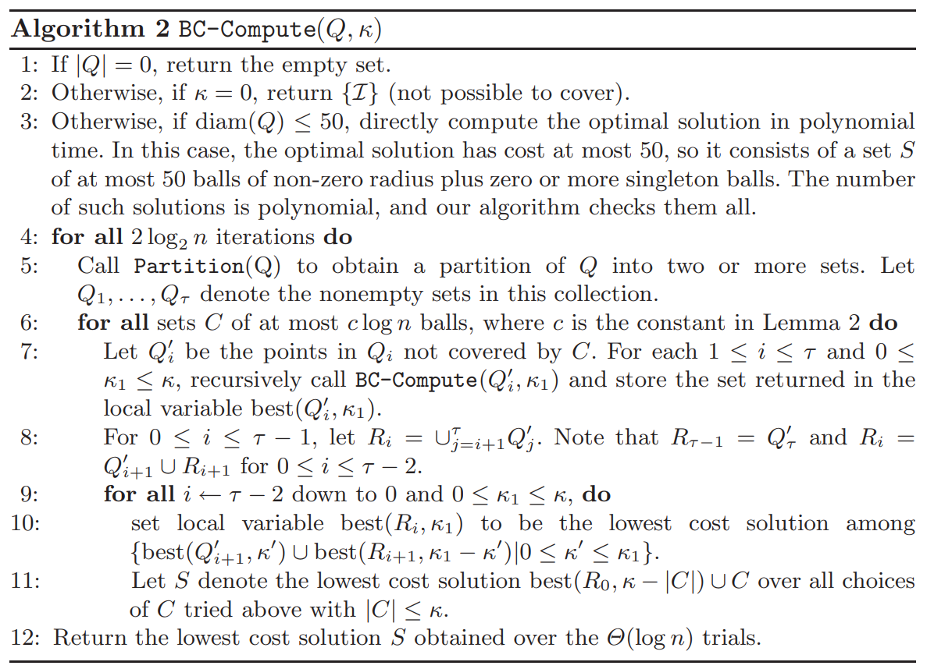

Brute-Force if instance is small
Partition
Guess cut Balls
Recursive calls
Do -
${2log}_{2}n$ trials
DP

Slide 30


Runnning time.
Recursion depth:
$$O(log Δ)$$
Each costing:
$n^{O(log n) }$
$⇒{(n^{O(log n) })}^{O(log Δ) }= n^{O(log n∗log Δ)}$

Slide 31

Correctness.
Correctness Overview
Event 1: A “good partition” occurs
Event 2: Correct guess for C
Event 3: All recursive calls return ${OPT}_{i}$
Event 4: DP recombination reconstructs OPT

Slide 32

Correctness.
Goal
Show by induction on |Q| that for any instance (Q,k) with $|Q|≥2$, BC-Compute(Q,k) returns an optimal k-cover of Q with probability at least
$$1−\frac{∣Q∣−1}{n^{2}}.$$

Slide 33
Correctness.
Base cases
proof by induction on |Q|.
If (Q,k) is a base-case instance the algorithm is correct with probability 1.
So the base of the induction holds.

Slide 34

Correctness.
Induction hypothesis
proof by induction on |Q|.
Assume that for every smaller instance (Q‘,k‘) with |Q‘|<|Q| the algorithm returns an optimal cover with probability at least
$$1−\frac{∣Q^{′}∣− 1}{n^{2}}.$$
We will prove the claim for $\left(Q , κ\right)$.

Slide 35

Correctness.
Event 1: A “good partition” occurs
proof by induction on |Q|.
Partition(Q) returns a “good” partition (Q1, . . . , Qτ ) of Q into τ ≥ 2 sets ($≤c\log{n}$ balls of the OPT cover are cut) with probability at least $\frac{1}{2}$ .
If we make $2\log_{2}n$ independent trials, the probability that none are good is at most:
$$(1−\frac{1}{2}{ )}^{2\log_{2}n}=2^{−2\log_{2}n} ={(2}^{\log_{2}n})^{−2}=n^{−2}=\frac{1}{n^{2}}$$
Fix that partition.

Slide 36
Event 2: Correct guess for C
Correctness.
proof by induction on |Q|.
The algorithm tries all C with |C| ≤ c log n.
Thus one guess equals C⋆ = {cut balls of OPT}.
Fix this choice.

Slide 37
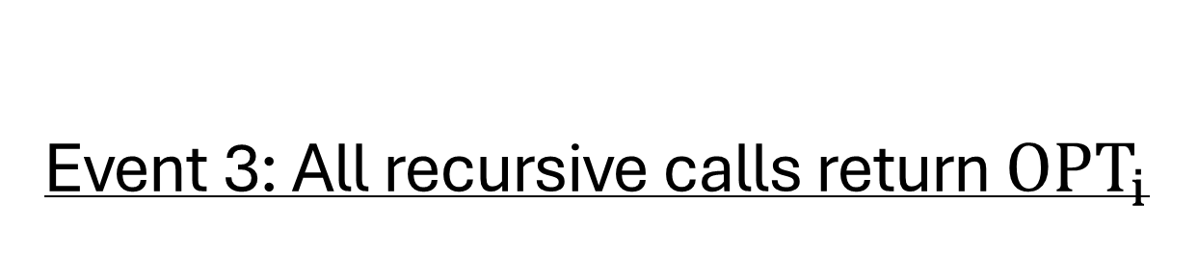

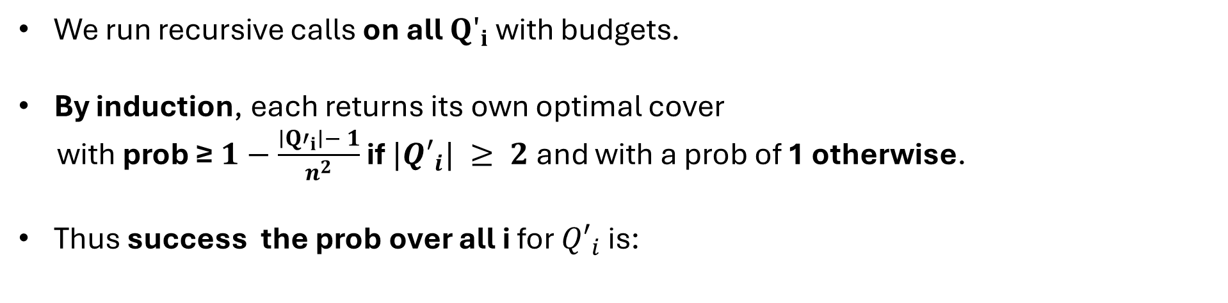

Event 3: All recursive calls return ${OPT}_{i}$
Correctness.
proof by induction on |Q|.
We run recursive calls on all ${Q′}_{i}$with budgets.
By induction, each returns its own optimal cover
with prob ≥$1−\frac{∣{Q′}_{i}∣− 1}{n^{2}}$ if $|{Q′}_{i}| ≥ 2$ and with a prob of 1 otherwise.
Thus success the prob over all i for ${Q′}_{i}$ is:
$$\prod_{i=1}^{m}{(1−a_{i})≥1−\sum_{i=1}^{m}{a_{i}}}$$
$$\prod_{i:|{Q′}_{i}|≥2}{1−\frac{∣{Q′}_{i}∣− 1}{n^{2}}} ≥\prod_{i}{1−\frac{∣Q_{i}∣− 1}{n^{2}} ≥ 1−\sum_{i}{\frac{∣Q_{i}∣− 1}{n^{2}}} = 1−\frac{\sum_{i}{(|Q_{i}∣− 1)}}{n^{2}}}$$
$$= 1−\frac{\sum_{i}{|Q_{i}∣}−\sum_{i}{1}}{n^{2}} = 1−\frac{|Q|−\text{τ}}{n^{2}}≥1−\frac{|Q|−\text{2}}{n^{2}}≥1−\frac{|Q|−\text{1}}{n^{2}}$$
$$≥1−\frac{|Q|}{n^{2}} =1−\frac{n}{n^{2}} = 1−\frac{1}{n}$$
Fix these solutions.

Slide 38

Correctness.
Event 4: DP recombination reconstructs OPT
proof by induction on |Q|.
Because OPT splits cleanly by regions and the DP tries all budget splits, the DP reconstructs exactly
$$\bigcup_{i}{OPT_{i}}$$
with cost = ∑ cost($OPT_{i}$).
Then we add C⋆ with cost = cost(C⋆).
Total = cost(OPT).

Slide 39



Success Probability
Correctness.
proof by induction on |Q|.
$$Pr\left(Success\right)=Pr\left(E1\right)∗Pr\left(E2 | E1\right)∗Pr\left(E3 | E1,E2\right)∗\left(E4 | E1,E2,E3\right)$$
$$≥(1−\frac{1}{n^{2}})∗1∗(1−\frac{1}{n})∗1=(1−\frac{1}{n^{2}})∗(1−\frac{1}{n})$$
n=20:
$$1−\frac{1}{n}=1−\frac{1}{20}=0.95$$
$$⇒ OPT with 95\%$$
n=1000:
$$1−\frac{1}{1000}=0.999$$
$$⇒ OPT with 99.9\%$$
$$≈1−\frac{1}{n}\text{ (}\text{for} \text{sufficiently} \text{large} \text{n}\text{)}$$

Slide 40

Theorem 1.
Theorem 1. There is a randomized algorithm that, given a set P of n points in a metric space and an integer k, runs in $n^{O(log n∗log Δ)}$ time and returns, with probability at least 1/2, an optimal k-cover for P.
Notes:
Add the inequality and short proof sketch from Gibson.

Slide 41
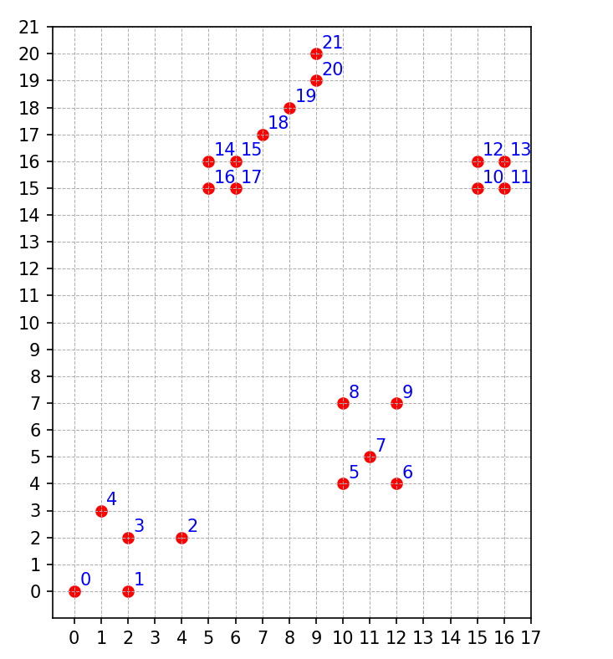

QUIZ
Consider a set $Q$ of 22 points in a metric space, as shown in the plot.
Suppose we call the function partition(Q) with the following parameters obtained randomly:
$π=\text{3 1 7 0 9 8 12 2 4 14 15 5 10 21 20 6 11 13 16 19 18 17}$
$β$ = 5
Using these inputs, the partition algorithm produces subsets $Q_{1},Q_{2},…$of $Q$.
Task: Calculate the resulting partitions $Q_{i}$ generated by the algorithm. Clearly show which points belong to each $Q_{i}$.

Slide 42
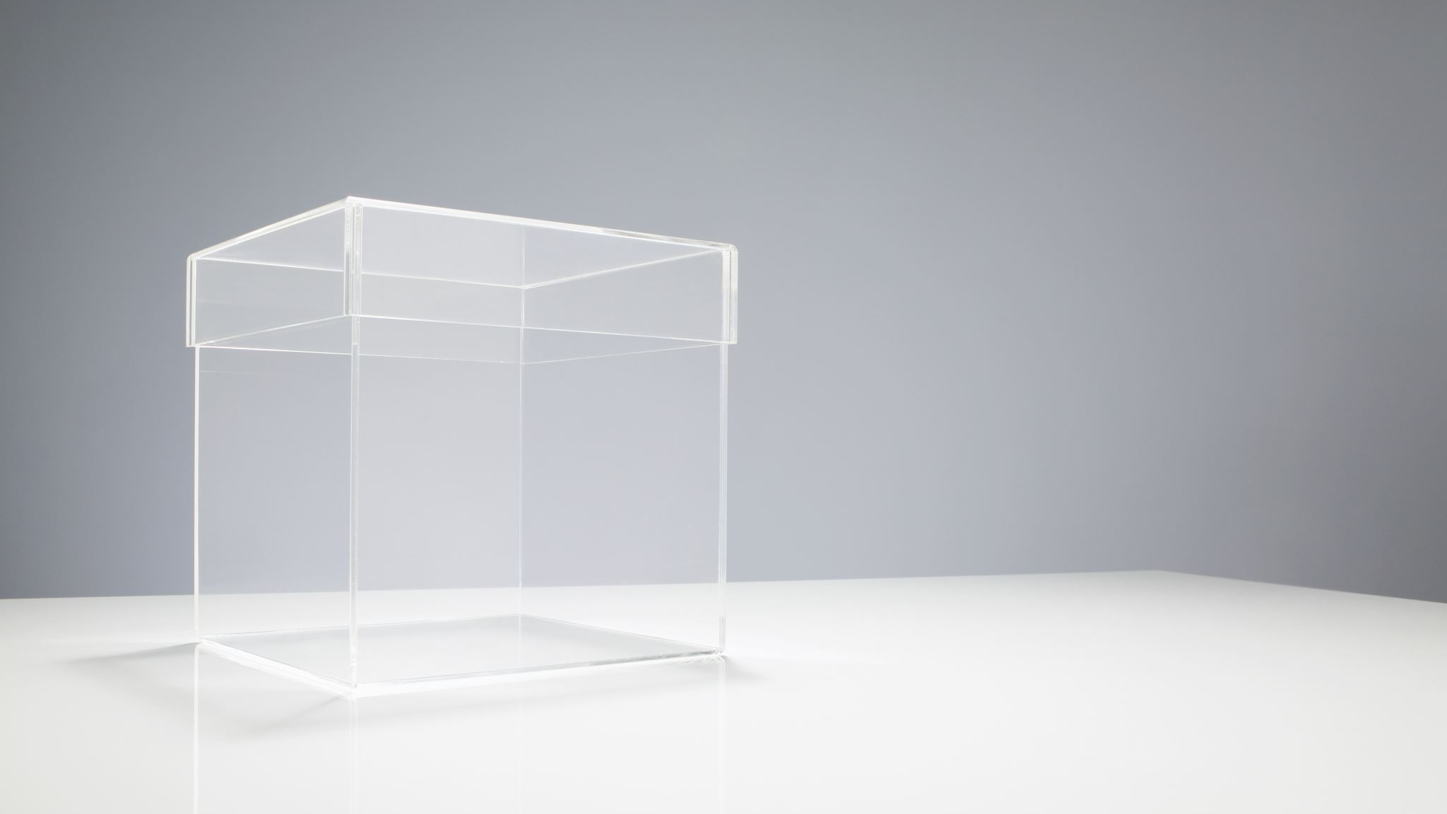
Stand of Research and open problems

Slide 43

Complexity: MSR is NP-hard for general metrics — even for planar/low-dimension metrics.
State of the art (poly time):
Recent algorithms achieve 3 + ε (Buchem et al., 2023/24)
Recently (2024) Friggstad & Jamshidian report a 3.389-approximation (improving the long-standing 3.504 of Charikar & Panigrahy).
Tight approximability threshold Is there a hardness result ruling out approximation below some constant $c$(e.g. 3) unless P=NP or under UGC?
Current literature improves algorithms toward $3$, but matching lower bounds are incomplete. (Prove tight inapproximability or improve algorithms past $3$.)

Slide 44

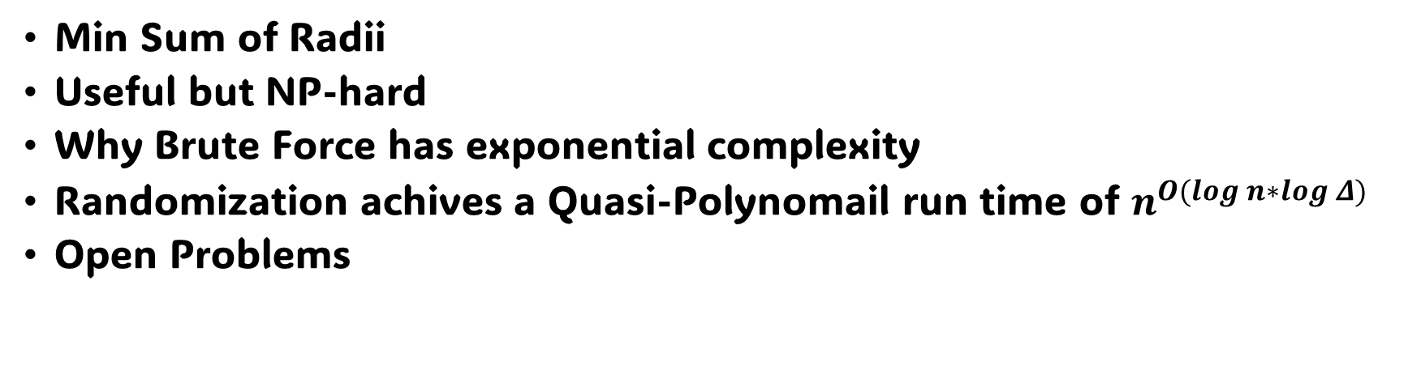
Summary
Min Sum of Radii
Useful but NP-hard
Why Brute Force has exponential complexity
Randomization achives a Quasi-Polynomail run time of $n^{O(log n∗log Δ)}$
Open Problems

Slide 45
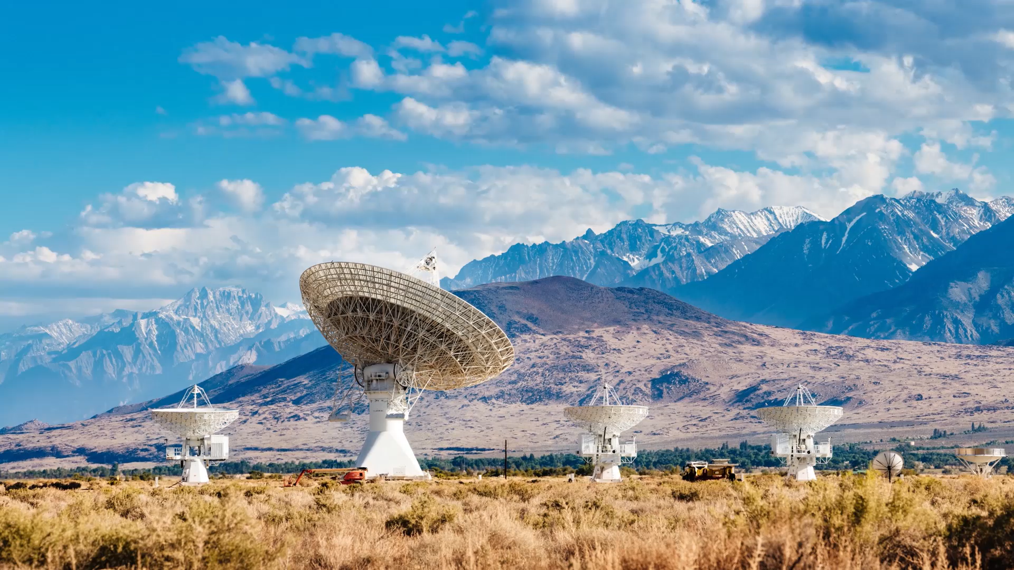
Q&A
Thank you for your Attention! Any questions?

